Slide 1
CUDA programming
软件学院 杨伟光
推荐配色
推荐字体：
微软雅黑
微软雅黑
宋 体
Arial Unicode MS
+
+

Slide 2
Menu
Programming Model
Execution Model
Memory Model
Optimization
Streams
CUDA Libraries

Slide 3
Menu
CUDA Tools
Experience to Learn CUDA

Slide 4
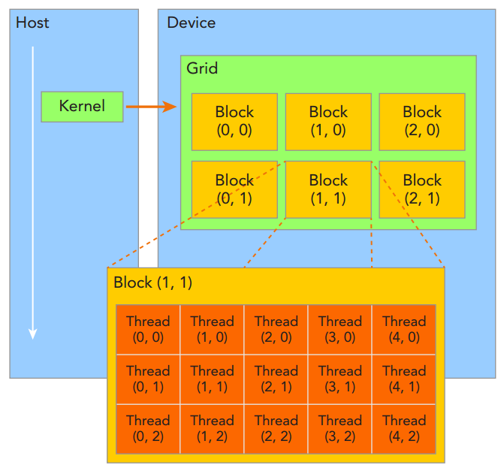
Programming Model
Grid: all threads in one kernel
Block: one grid including several blocks

Slide 5
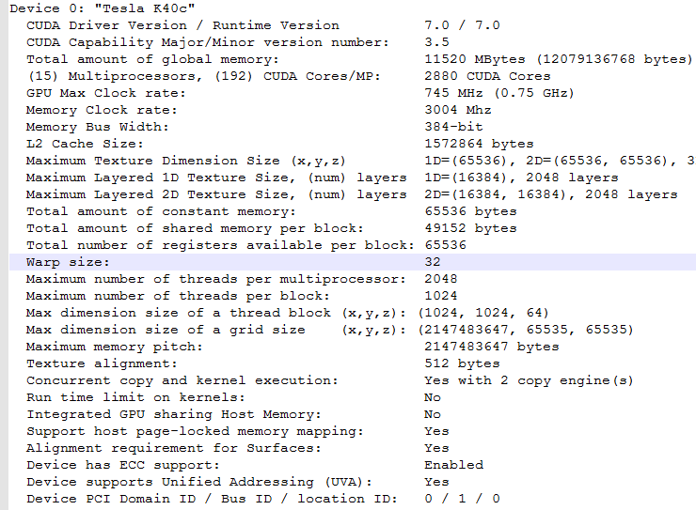
Programming Model
Grid: all threads in one kernel
Block: one grid including several blocks

Slide 6
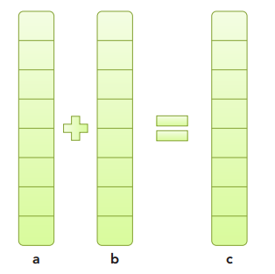
Programming Model
Example
vectorAdd
A typical processing flow of a CUDA program follows this pattern: 1. Copy data from CPU memory to GPU memory. 2. Invoke kernels to operate on the data stored in GPU memory. 3. Copy data back from GPU memory to CPU memory.

Slide 7
Programming Model
Timing Your Kernel
http://blog.csdn.net/litdaguang/article/details/50520549

Slide 8
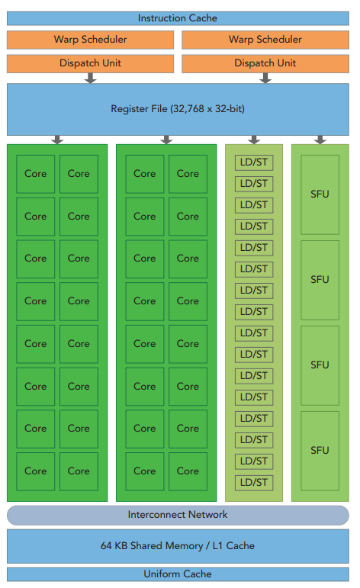
Execution Model
the key components of a SM: ➤ CUDA Cores ➤ Shared Memory/L1 Cache ➤ Register File ➤ Load/Store Units ➤ Special Function Units ➤ Warp Scheduler

Slide 9
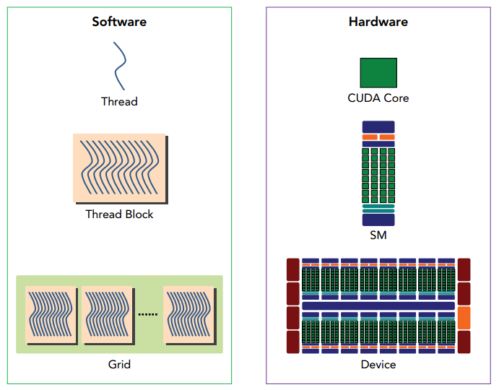
Execution Model
A thread block is scheduled on only one SM. Once a thread block is scheduled on an SM, it remains there until execution completes. An SM can hold more than one thread block at the same time.

Slide 10
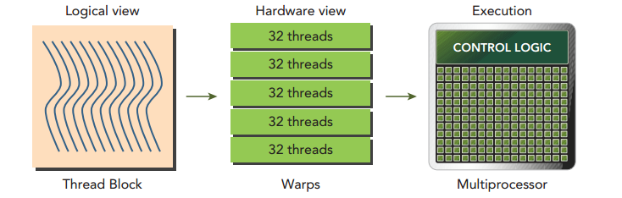
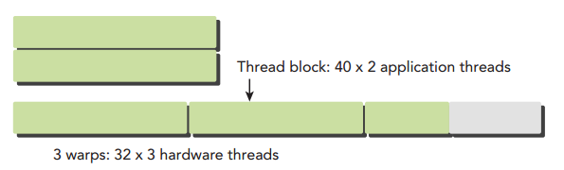
Execution Model
Each 32 threads in block organized into warp
warp is the execution unit in GPU

Slide 11
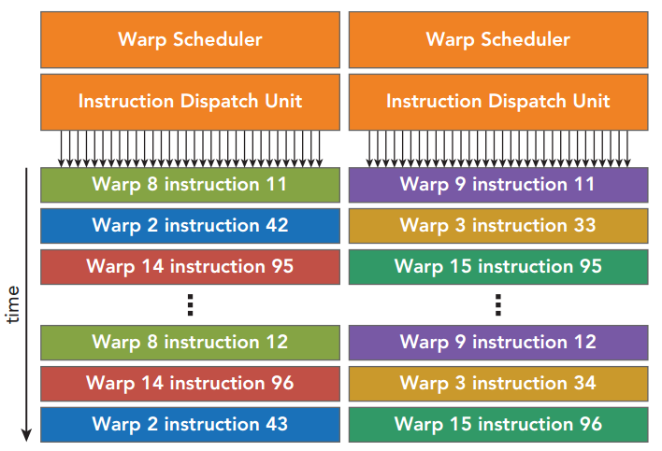
Execution Model
Out-of-order execution model
ready
stall
running
finish

Slide 12
Execution Model
线程1
线程2
线程3
线程4
Atomic Instruction
顺序访问方式
write
An atomic instruction performs a mathematical operation, but does so in a single uninterruptable operation with no interference from other threads.

Slide 13
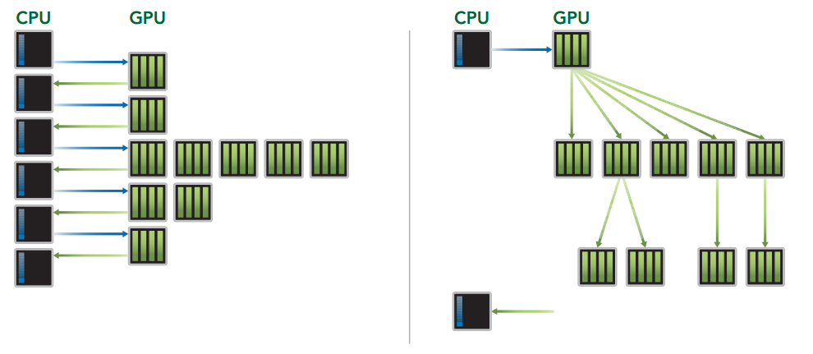
Execution Model
Dynamic Parallelism
Dynamic Parallelism is a new feature introduced with Kepler GPUs that allows the GPU to dynamically launch new grids.
/NVIDIA_CUDA-7.0_Samples/0_Simple/cdpSimpleQuicksort

Slide 14
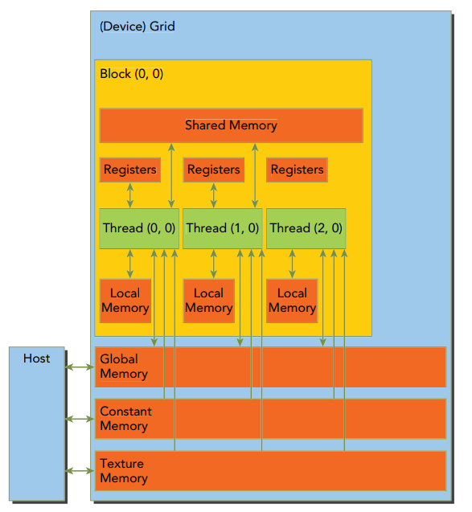
Memory Model
➤ Registers ➤ Shared memory ➤ Local memory ➤ Constant memory ➤ Texture memory ➤ Global memory
Onchip
Offchip

Slide 15
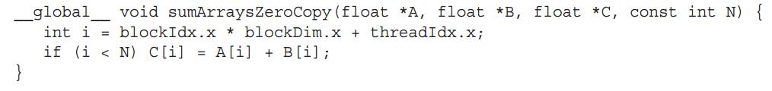
Memory Model
Registers
(1) the fastest memory space on a GPU (2) there is a hardware limit of registers per thread. [Fermi:63] [Kepler:255]

Slide 16
Memory Model
Local memory
Variables in a kernel that are eligible for registers but cannot fit into the register space allocated for that kernel will spill into local memory.
➤ Local arrays referenced with indices whose values cannot be determined at compile-time.
➤ Large local structures or arrays that would consume too much register space.
➤ Any variable that does not fit within the kernel register limit.
__global__ void test(int size)
{
int *arr1 = (int*)malloc(size);
float arr2[200];
}

Slide 17
Memory Model
Shared memory
Variables decorated with “__shared__” in a kernel are stored in shared memory
Static shared memory and dynamic shared memory
Each SM has a limited amount of shared memory. [48K]
Shared memory shares its lifetime with a thread block. [inter-thread communication]
The L1 cache and shared memory for an SM use the same 64 KB of on-chip memory, which is statically partitioned but can be dynamically configured at runtime.
cudaError_t cudaFuncSetCacheConfig(const void* func, enum cudaFuncCache cacheConfig); cudaFuncCachePreferNone: no preference (default) cudaFuncCachePreferShared: prefer 48KB shared memory and 16KB L1 cache cudaFuncCachePreferL1: prefer 48KB L1 cache and 16KB shared memory cudaFuncCachePreferEqual: Prefer equal size of L1 cache and shared memory, both 32KB

Slide 18
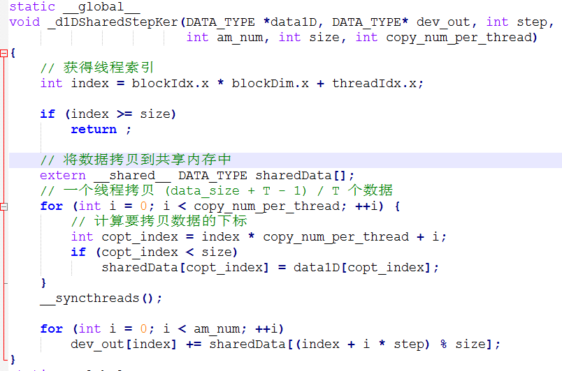
Memory Model
Shared memory Example

Slide 19
Memory Model
Shared memory Example
Shared memory
bank conflicts

Slide 20

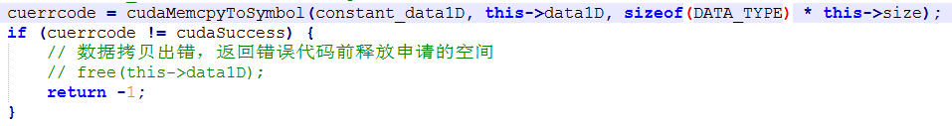
Memory Model
Constant memory
Variables decorated with “__constant__” in a kernel are stored in constant memory
Each GPU has a limited amount of shared memory. [64K]
The throughput of constant memory is 4B per clock per SM. Unless an entire warp reads the same address, replays are needed.
Constant memory is statically declared and visible to all kernels

Slide 21
Memory Model
Texture memory
Hardware interpolation
Texture objects can interoperate graphics(OpenGL, DirectX)
Format conversion {char, short, int} -> float

Slide 22
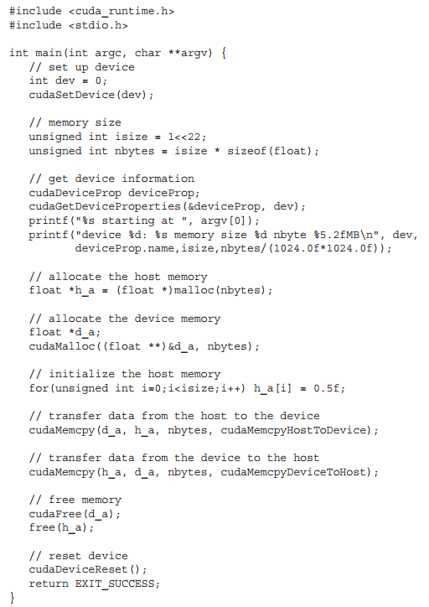

Memory Model
Global memory
Dynamic Global Memory:
➤ Allocate and deallocate device memory ➤ Transfer data between the host and device

Slide 23
Memory Model
Global memory
Dynamic Global Memory:
➤ Allocate and deallocate device memory ➤ Transfer data between the host and device
1. Copy data from CPU memory to GPU memory. 2. Invoke kernels to operate on the data stored in GPU memory. 3. Copy data back from GPU memory to CPU memory.

Slide 24
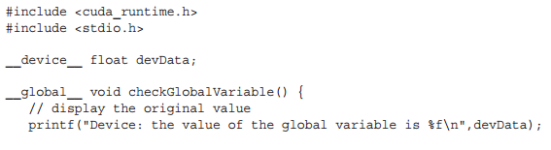
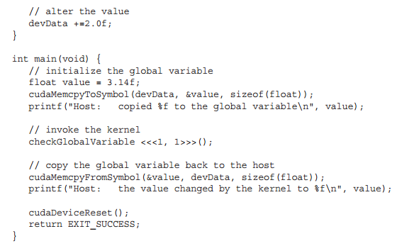
Memory Model
Global memory
Static Global Memory:

Slide 25
Memory Model
➤ Registers ➤ Shared memory ➤ Local memory ➤ Constant memory ➤ Texture memory ➤ Global memory
Read-only Cache, Pinned Memory, Zero-Copy Memory, Unified virtual addressing
Shared Memory: bank conflict, data layout
Global Memory access patterns: Aligned and Coalesced Access
L1/L2 Cache
Warp shuffle instruction

Slide 26
Optimization
Three Bottle-Necks：Memory / Instruction / Latency
Memory bandwidth bound: GDDR/L2/TEX/L1/Shared Memory bandwidth etc.
Instruction throughput bound: single/double-precision/LDST/SFU throughput etc.
Latency bound: No enough warp to switch in while waiting.

Slide 27
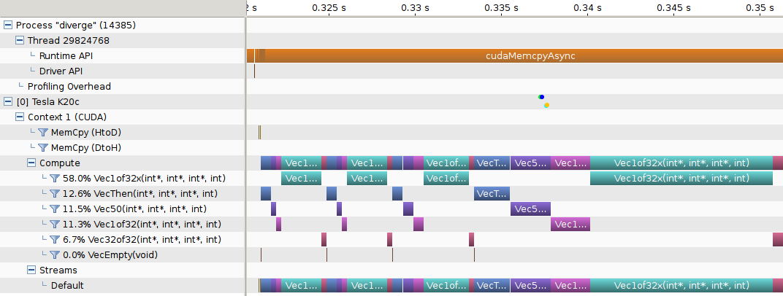
Optimization
How to find bottle-necks?
http://docs.nvidia.com/cuda/profiler-users-guide/index.html
NVIDIA visual profiler (NVVP)
NVPROF
Command Line Profiler

Slide 28

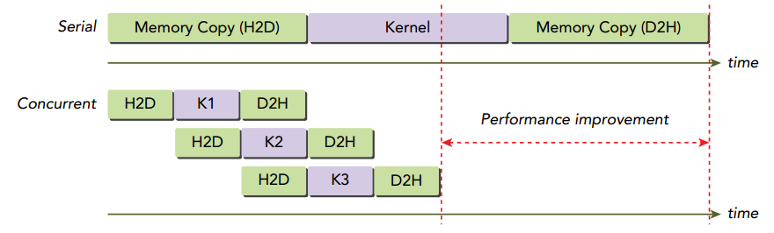
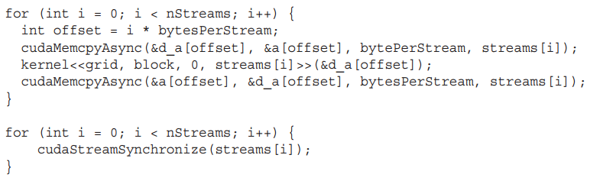
Streams

Slide 29
Streams
Stream operations
cudaStream_t stream; cudaStreamCreate(&stream); cudaStreamDestroy(cudaStream_t stream);
cudaStreamSynchronize(cudaStream_t stream);
cudaStreamQuery(cudaStream_t stream);
cudaMemcpy()
cudaMemcpyAsync(void* dst, const void* src, size_t count,cudaMemcpyKind kind, cudaStream_t stream = 0);
kernel<<< .. , .. >>>
kernel_name<<<grid, block, sharedMemSize, stream>>>(argument list);

Slide 30
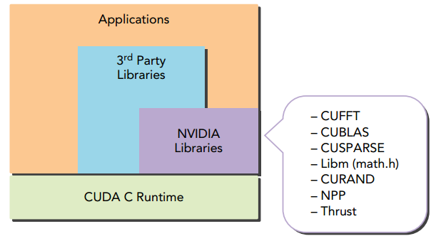
CUDA Libraries
https://cudazone.nvidia.cn/gpu-accelerated-libraries/

Slide 31
CUDA Tools
编辑器：
sublime text + cuda snippets 插件
Nsight Eclipse Edition
调试器：cuda-gdb，Nsight，CUDA-MEMCHECK
性能分析工具：NVIDIA Visual Profiler(NVVP)， nvprof
cuda docs (http://docs.nvidia.com/cuda/index.html)

Slide 32
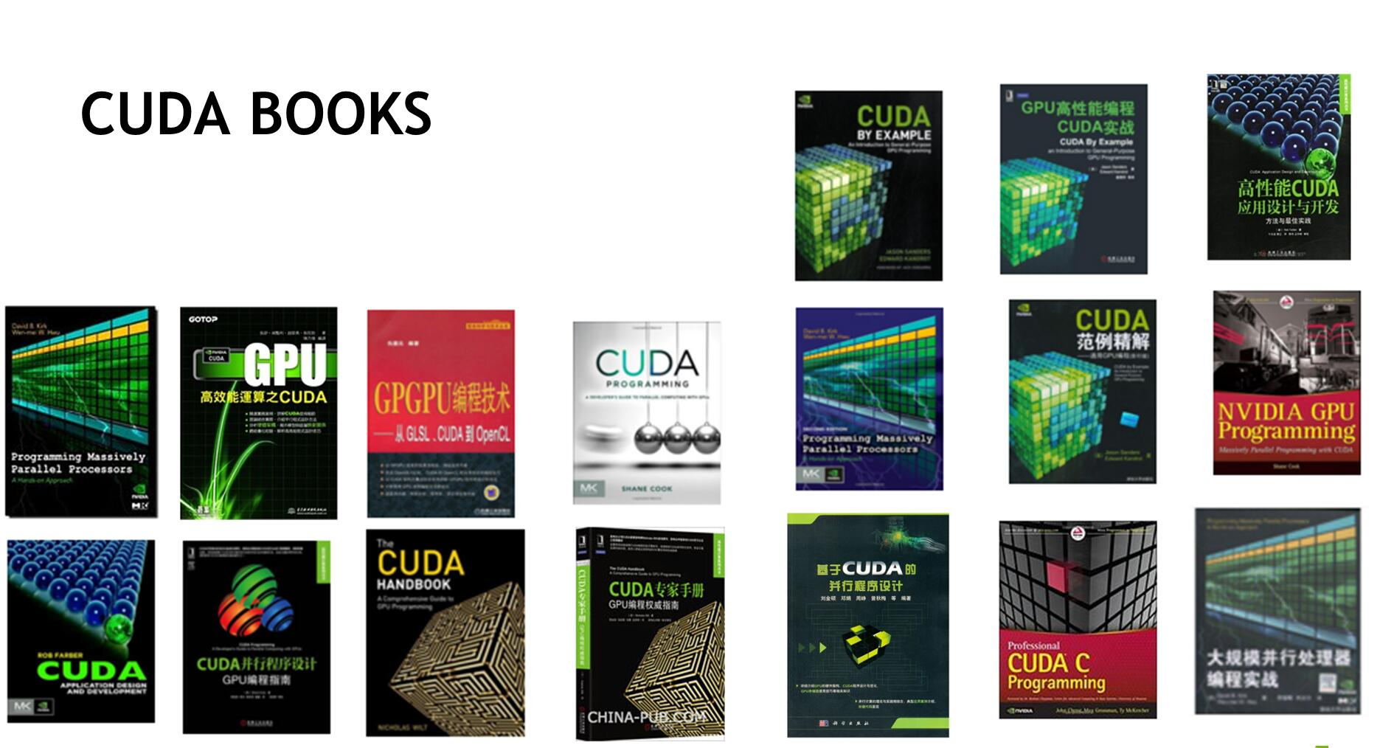
Experience to Learn CUDA
官网入门文档：<<CUDA C Programming Guide>>
代码：cuda sdk example, openCUDA (https://github.com/LitLeo/OpenCUDA)
CUDA群：CUDA Professional (45157483)
Stack Overflow (http://stackoverflow.com/)
CUDA 书籍

Slide 33
Thanks

